Slide 1
Secure Electronic Transaction

Slide 2
It is an open encryption and security specification to protect credit card transactions on the internet
SET is not itself a payment system , but it is a set of security protocols and formats that enables users to employ the card payment system on an open n/w
SET provides 3 services
1.Provides a secure communication channel among all parties in transaction
2.Provides trust by the use of X.509V3 digital certificates
3.Ensures privacy because the info is available to parties when and where necessary

Slide 3
SET is a complex specification and is defined in 3 books
Book 1-Business description
Book 2-Programmers guide
Book 3 –Formal protocol definition
SET is generally divided into 3 sections
1.Requirements
2.Key features
3.SET participants

Slide 4
1.Requirements
Book1 lists the following requirements for secure payment processing with credit cards over the internet
  1.Provide confidentiality of payment and ordering information
  To assure that the infor is safe and accessible only to the correct receiver
  2.Ensure the integrity of all transmitted data
  To ensure that no changes in the content occur

Slide 5
3.Provide authentication that a card holder is a legitimate user of a credit card account
Digital signatures +certificates are used to verify that a cardholder is a legitimate user of a valid account
4.Provide authentication that can accept credit card transactions through its relationship in a financial institution
5.Ensure the use of best security services to protect all legitimate parties
6.Create a protocol that neither depends on transport security nor prevents their use
7.Facilitate and encourage interoperability amg s/w and n/w providers

Slide 6
2.Key Feature of SET
1.Confientiality of information
2.Integrity of data
3.Cardholder acct authentication
4.Merchant authentication
3.SET Participants
1.Cardholder
Authorized holder of a payment card that has been issued by an issuer
2.Merchant
It is a person /organization that has goods or services to sell to the card holder

Slide 7
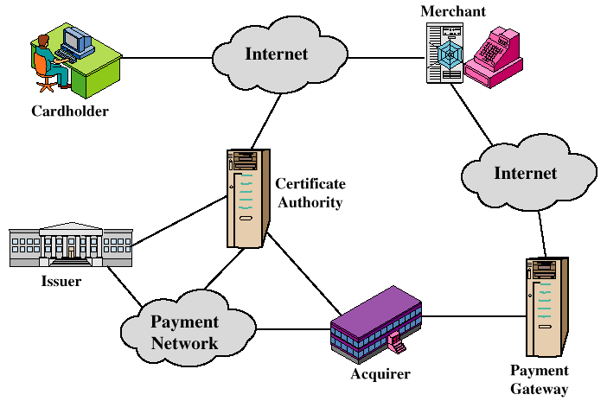
Secure Electronic Commerce Components

Slide 8
3.Issuer
It is financial institution such as a bank that provides the cardholder with the payment card
4.Acquirer
A financial institution that establishes an account with a merchant and processes payment card authorizations and payments
Provide electronic transfer of payment to merchant account
5.Payment Gateway
Interfaces b/w SET and existing bankcard payment n/w for authorization and payment fun’s
This is the fun operated by the acquirer of a designated third party that processes merchant payment msgs

Slide 9
6.Certification Authority(CA)
It is a trusted authority that issue X.509V3 certificates for cardholders merchants and payment gateways

Slide 10
Steps to form a Secure Electronic Transaction
1.Customer opens an account
2.Customer receives a certificate
3.Merchants have their own certificates
4.Customer places an order
5.Merchant is verified
6.The order and payment are sent
7.Merchant requests payments authorization
8.Merchant confirms the order
9.Merchant provides goods/service
10.Merchant requests payment

Slide 11
Dual Signature
Important concept of SET
The purpose of dual signature is to link 2 msgs that are intended for 2 diff recipients
Here customer want to send the order infor(OI)to the merchant and the payment infor(PI) to the banker
Link is needed so that the customer can prove that this payment is intended for this order and not for some other goods/service

Slide 12
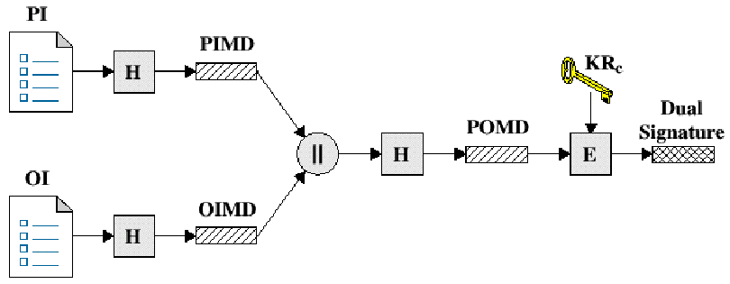

Slide 13
PI-Payment information
OI-order information
H-hash fun
PIMD-PI msg digest
OIMD-OI msg digest
POMD-payment order msg digest
E-encryption(RSA)
KRc-Customers private signature key

Slide 14
Working
First the customer takes the hash of PI and hash of OI. These 2 hashes are then concatenated and the hash of the result is taken
Finally the customer encrypts the final hash with his/her private signature key and thus creating the dual sig
ie Ds=E_{KRC}[H(H(PI)||H(OI))]
Here KRC is the customer private signature key
If the merchant is in possession of dual sig(DS),the OI,and the msg digest for the PI(PIMD)
The merchant also has the public key of the customer , taken from the customer certificate

Slide 15
The merchant can compute the following 2 quantities
H(PIMD||H(OI)) and D_{(PUC,}DS]
Where KUC is the customer public signature key
If these 2 quantities are equal,then the merchant has verified the signature
Similarly ,if the bank is in possession of DS,PI and msg digest for OI(OIMD) and the customers public key , then bank can compute the following
H(H(PI)||OIMD) and D_{KUC}[DS]

Slide 16
Again if these 2 quantities are equal, then the bank has verified the signature ie
1.Merchant has received OI and verified the signature
2.Bank has received PI and verified the signature
3.Customer has linked the OI and PI and can prone the linkage

Slide 17
Payment Processing
Payment processing of SET consist of the following transactions
1.Purchase request
2.Payment authorization
3.Payment Capture
Purchase Request
Purchase request exchange consist of 4 msgs
1.Initiate request: Customer requests the certificate in this msg sent to the merchant
2.Initiate Response: It includes the merchant signature certificate and the payment gateway key exchange certificate
2.Initiate Response: It includes the merchant signature certificate and the payment gateway key exchange certificate

Slide 18
3.Purchase Request : It includes purchase related information and cardholder certificate
4.Purchase Response : It includes a response block that acknowledges the order and reference the corresponding transaction number
Payment Authorization
It ensures that the transaction was approved by issuer
This exchange consists of 2 msgs
1.Authorization request:It consist of purchase related info , authorization related info , certificates
2.Authorization Response:It includes authorization related infor , capture token infor and certificate(gateway sig key certificate)

Slide 19
Payment Capture
Payment capture exchange consist of a capture request and capture response msg
1.Capture request : It includes the payment amt and transaction ID encrypted capture token + merchants signature key + key exchange key certificate
2.Capture response : Capture response block that the gateway signs and encrypts +gateway signature

